Slide 1


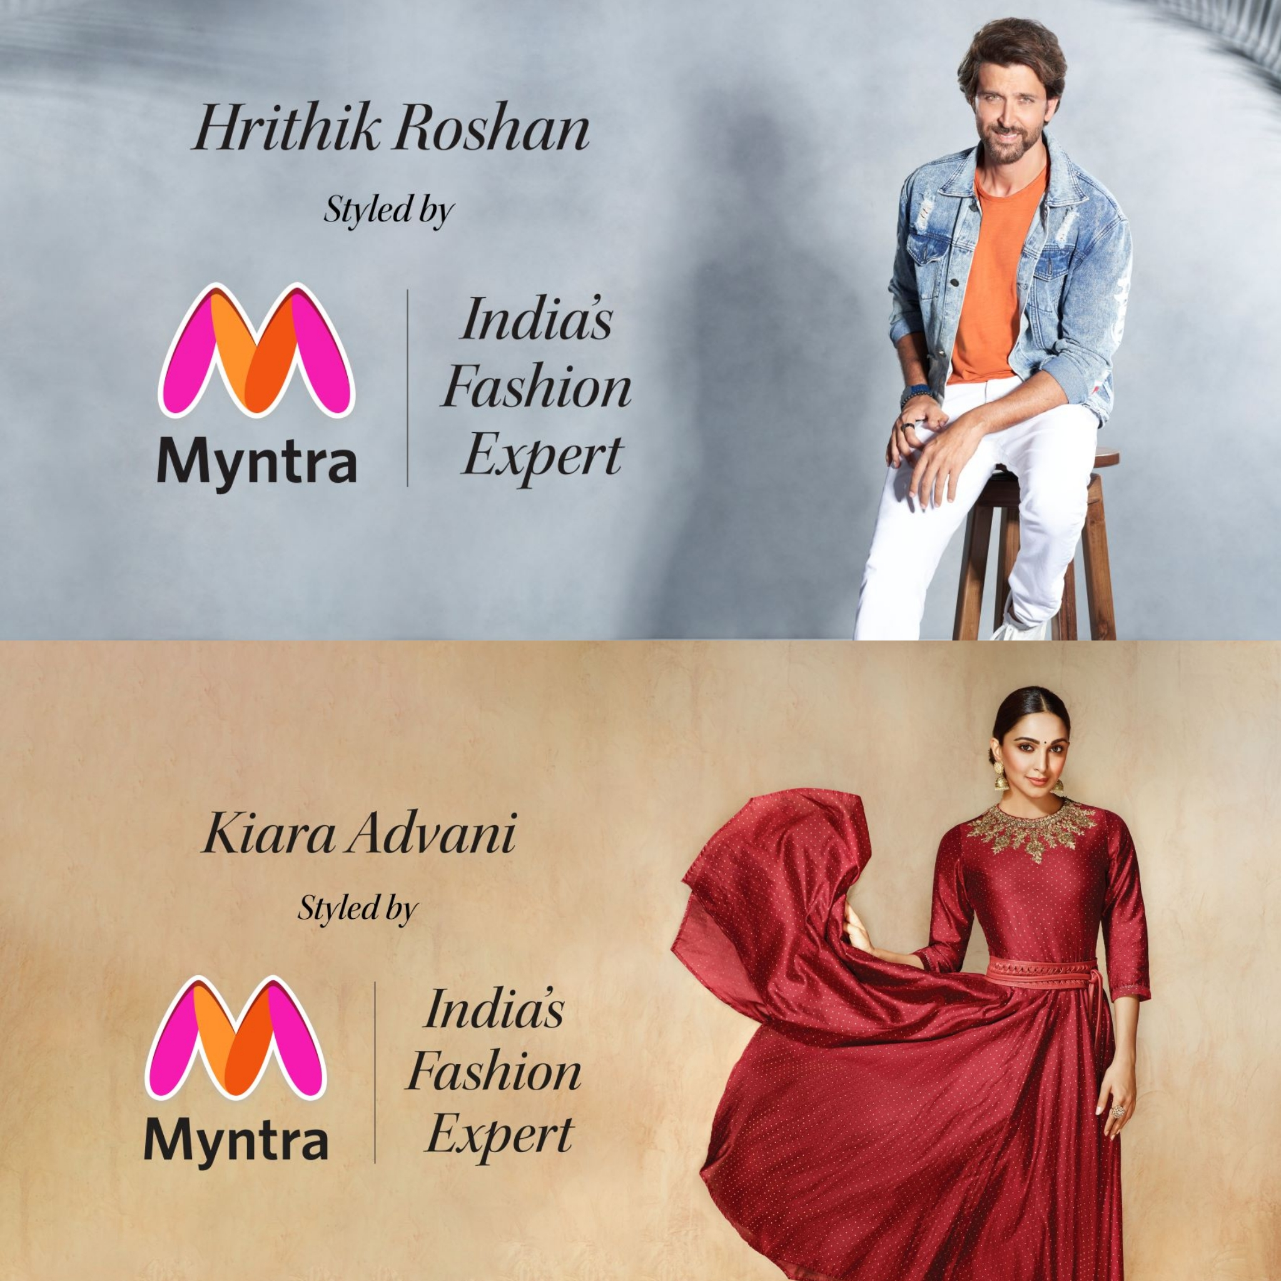
MYNTRA ANALYSIS
BE EXTRAODINARY EVERY DAY
RM. SREESAVITHA
BADM-WD-T-B5

Slide 2



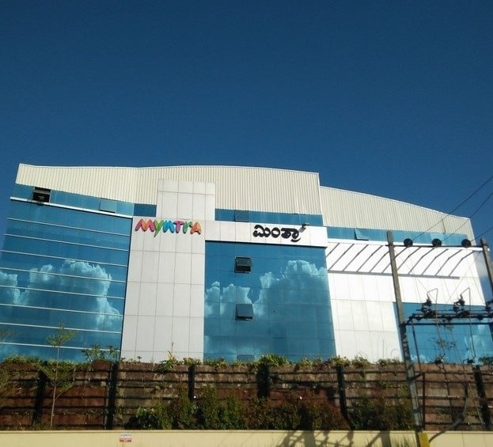
The Brand Which Revolutionized the Online Fashion Industry
COMPANY FOUNDATION
FOUNDERS
Mukesh Bansal, Priyanka Kumar, Ashutosh Lawania, Vineet Saxena, Sankar Bora and Raveen Sastry.
VISION & MISSION
To Democratize Fashion and Life-style through Technology, emphasizing sustainability.
VALUES & PRINCIPLES
Myntra's value proposition revolves around giving consumers the power and ease of purchasing fashion and lifestyle products online.

Slide 3

COMPANY
OVERVIEW
Industry Type
Product Type
Founded on
Head-Quarters
Products
Services
Features
Parent
Partnership
Indian Fashion E-Commerce Industry
Sells Fashion & Life-style Products
In 2007-2008 as an online portal for Personalized Gifts.
Bengaluru, Karnataka.
Offers wide Range of products over 500 Brands, including Adidas, Nike, Puma, etc.,.
Includes Cash-on-Delivery, 30-day return policy, & a dedicated customer support team.
Try & Buy "Virtual Try On" feature, alteration as services, and an M- express delivery services.
Acquired by Flipkart in 2014 by $375 Million.
Myntra has partnered with many well-known brands to expand its portfolio.

Slide 4

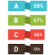
Myntra's business model includes a Pure Play MarketPlace (PPMP) model, in this sellers store and pack their products,& Myntra handles Logistics and a Merchant Seller Agreement (MSA) model.
Myntra has embraced an aggregator business model strategy, which marks a smooth integration of online and offline retail dynamics and facilitates direct consumer-brand interactions (B2C) from its initial business-to-business (B2B) model.
The core of Myntra's business strategy is to procure the newest products from affiliated companies by the current fashion.
BUSINESS MODEL

Slide 5
MILESTONE OF MYNTRA
2007 - Founded Myntra as an online retailer of Personalized gifts.
2011 - Became an online portal for selling Fashion & Life-style products.
2014 - Myntra was Acquired by India's leading E-commerce platform Flipkart for over $300 Million.
2015 - Became an App - only platform to focus on mobile shopping.
2016 - Launched Try & Buy feature "Virtual Try on" and AI-driven recommendations.
2016 - Became India's Largest Fashion platform by acquiring Jabong.
2017 - Partnered with Ministry of Textiles to promote the Handloom Industry.
2017 - Digital native Myntra houses a Range of private labels that contribute up to 40% to its Gross Merchandise Value (GMV).
2018 - Became part of the Walmart group.

Slide 6
MILESTONE OF MYNTRA
2019 - Started Alteration as a service.
2022 - Launched an Express delivery service on its app.
2023 - Received the Platinum certification in the Existing Interior category from the Indian Green Building Council (IGBC).
2023 - Myntra's marketplace entity turned EBITDA positive since the last quarter of CY 2023.
Puma India awarded Myntra with the "Best E-commerce partner of the year 2011-2012".
Myntra has partnered with over 2000 leading fashion and lifestyle brands in the country such as Fossil group, OOMPH, BEWAKOOF, Uptownie, House of Pataudi, Anouk, Roadster, HRX, All About You, Marks & Spencer, Nike, Adidas, Puma , Levis , wrangler , Arrow, Diesel, Biba , W, US polo , Wrogn, Ralph Lauren, Fashion 21,Mango, Mac and many more to offer a wide range in latest branded fashion …

Slide 7






MARKET POSITION & GROWTH
MARKET SHARE
Holds an 55% of the online fashion market based on monthly active users.
GROWTH
Has been growing faster than the online fashion market since the second half of 2023.
PROFITABILITY
Has been operationally profitable for Two quarters.
EXPANSION
Is Expanding into Non-Apparels, Beauty, International Brands & D2C brands.
CUSTOMER COHORTS
Is winning new customer cohorts, including Gen Z.
GEOGRAPHICAL
It also expanded as Geographically in Non-Metro cities.

Slide 8

MYNTRA REVENUE MODEL
Profits from selling Fashion & Life-style products Directly to customers through its online platform.
DIRECT SALES MODEL
MARKETPLACE MODEL
2. Commissions from Third-party sellers for allowing to list their products, as it operates as marketplace.
SUBSCRIPTION MODEL
3. Subscription fees by offering Membership & Loyalty services (e.g. Myntra Insider) like Discounts, early access to sales or exclusive collections.
ADVERTISING REVENUE
4. Brands' fees for granting access to its platform for tailored advertisements and promotional placements like private labels.
5. commission on sales generated through affiliate links by collaborating with bloggers and influencers to promote products.
AFFILIATE MARKETING

Slide 9
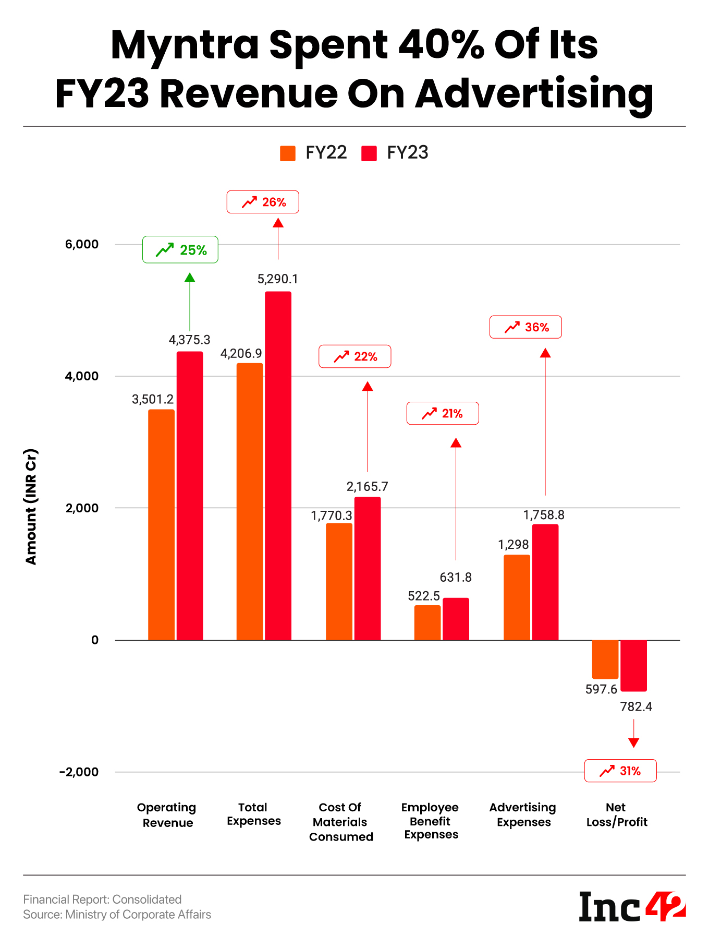





REVENUE REPORT of FY-2023
Annual Revenue: Nearly Rs.4,510cr as on Mar 31,2023.
Advertising Expenses : Spent about Rs.1,759cr on Advertising.
Employee Benefit: Expenses made for employee benefit for about Rs.631.8cr.
Total expenses: Expenses totally made in 2023 is Rs.5,290.1cr.
Net position: About Rs.782.4cr occurred as net loss in FY-2023.

Slide 10
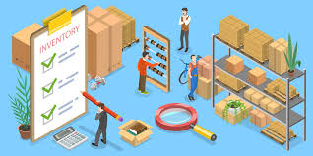
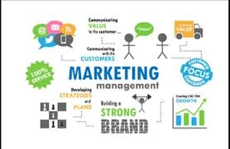
INVENTORY MANAGEMENT
Myntra uses real-time tracking, centralized fulfillment centers, and demand forecasting to manage stock levels and meet customer demand.
MARKETING MANAGEMENT
Myntra uses a combination of sponsored and organic digital marketing strategies, including pay-per-click, display ads, retargeting, and ad extensions.

Slide 11

TECHNOLOGY UTILIZATION
Augmented Reality (AR) & Virtual Reality (VR) | To provide a Personalized shopping experience like Virtually Try-on different clothing.
AI & Machine Learning | To improve product search and recommendation algorithms based on customer search by scanning digital space to know what customers likes.
Chatbot | Al-powered chatbot to provide customized suggestions.
ChatGPT-powered search | To enhance product discovery.
Druid & Power BI | Uses Druid a real-time analytics database & Power BI to visualize real-time traffic data.
Cloudflare CDN, Percona, Stoplight | Uses to make website run faster, Peak performance in data management, etc,.
Cloud service | Microsoft Azure Cloud Platform to maintain open source foundations across all stack layers of platform.

Slide 12

DATA ANALYTICS
CUSTOMER INSIGHTS
Collects vast amount of data from user interactions, purchase history, and browsing behavior which helps to understand customer preferences and trends.
2. INVENTORY MANAGEMENT
By Analyzing sales data and market trends Myntra can ensure stock on popular items by optimizing inventory levels and minimizing excess inventory.
3. SALES FORECASTING
Data analytics allows to predict future sales trends, enabling better planning for promotional campaign and seasonal stocks.
4. PERFORMANCE TRACKING
It uses analytics to monitor the effectiveness of marketing campaigns, website performance and user management, helping to refine strategies overtime.

Slide 13




PERSONALIZATION
PERSONALIZED RECOMMENDATIONS
Employs machine learning Algorithms to provide personalized product recommendations based on user behavior like past purchase and browsing history.
TAILORED MARKETING
Using Segmentation and Targeting, can send personalized email offers and notifications, enhancing customer engagement and conversion rates.
USER - INTERFACE CUSTOMIZATION
The Platform adjusts its layout and featured products based on individual user preferences, creating a more relevant shopping experience.
DYNAMIC PRICING
Myntra may implement dynamic pricing strategies that take into account user behavior, demand, and competitor pricing to optimize sales.

Slide 14



CHALLENGES AND FUTURE DIRECTIONS
DATA PRIVACY
Balancing personalization with user privacy concerns is critical, especially with increasing regulations around data usage.
REAL-TIME ANALYTICS
As E-Commerce evolves, real-time analytics will become increasingly important for immediate personalization and inventory adjustments.
ALGORITHM BIAS
Ensuring that algorithms do not inadvertently favor certain products or demographics is essential for fairness.

Slide 15

Analysis & Strategic Insights of MYNTRA
Competitor Analysis
SWOT Analysis
Customer sentiment Analysis
Market Trend Identification
Formulating Strategic Recommendations
by Customer feedback on Social Platforms

Slide 16
COMPETITOR ANALYSIS on KEY COMPONENTS
CRITERIA | MYNTRA | AMAZON FASHION | FLIPKART FASHION | AJIO | TATA CLiQ
Market share | 55% in online fashion | 25% in fashion | 20% in fashion | 10% in fashion | 5% in fashion
Product Range | Wide range of Brands & Styles, including Private Labels | Extensive Range & International brands | Diverse local & International brands | Focus on Ethnic wear & Trendy fashion | Premium brands & Electronics
Pricing Strategy | Competitive pricing with frequent sales | Variable, Discounts available | Competitive, Frequent sales | Affordable, seasonal discounts | Premium pricing, Occasional discounts
Customer Experience | User-friendly App, Easy returns | Comprehensive, Good service | Intuitive, Easy returns | Good service, Returns policy | Good service, Premium feel

Slide 17
COMPETITOR ANALYSIS on KEY COMPONENTS
CRITERIA | MYNTRA | AMAZON FASHION | FLIPKART FASHION | AJIO | TATA CLiQ
Marketing & Branding | Celebrity endorsements, strong Social media presence | Strong online presence, various Campaigns | Big Billion Days, Influencer marketing | Targeted Campaigns for Youth | Premium Branding, Exclusive collections
Technology & Innovation | AR Try-ons, Personalized recommendations | AI-driven recommendations | Advanced search features | Virtual fitting room | Enhance online shopping experience
Logistics & Supply Chain | Fast delivery, Reliable network | Extensive logistics network | Efficient, Varied delivery options | Fast delivery for Urban areas | Premium delivery options

Slide 18
COMPETITOR ANALYSIS on CHALLENGES
CRITERIA | MYNTRA | AMAZON FASHION | FLIPKART FASHION | AJIO | TATA CLiQ
PRODUCT QUALITY | Inconsistent quality across brands | Varies widely among sellers | Varies among sellers | Mixed reviews on product quality | Limited product quality checks
CUSTOMER SERVICE | Slow response times in some cases | Overwhelmed support during peak times | Variable service quality | Limited service for returns | Premium pricing with limited support
DELIVERY ISSUES | Delivery times can be so long | Occasional delivery delays | Delivery issues in Remote areas | Limited logistics for Rural areas | High delivery charges
RETURN POLICY | Complicated returns processes | Strict return window | Limited return options for certain items | Short return window for some categories | Complicated return policies
WEBSITE / APP USUABILITY | can be Slow at peak times | Sometimes Cluttered with options | can be Overwhelming for users | Less user-friendly interface | Limited filters for Product searches
BRAND VARIETY | Limited exclusive high-end Brands | Too many options can confuse & delay conversion | Mixed quality among available brands | Limited options for western wear | Focuses more on Premium brands

Slide 19
SWOT ANALYSIS of MYNTRA
S
W
O
T
Strengths
Weakness
Opportunity
Threats
Strong Brand
Huge Variety
Focus on Customers
Advanced Technology
Good Brand Partnerships
Heavy Discounts
Urban-centric
Inventory challenges
High competition
Low Responsive
Delivery & Return
Online Shopping Strategies
Grow to Tier 2 & Tier 3 cities
Eco-Friendly Fashion
Better Personalization
More quality staffing
Strong competition
Delivery Issue
Feedback Remediation
Economic Slowdowns
Privacy Concerns

Slide 20

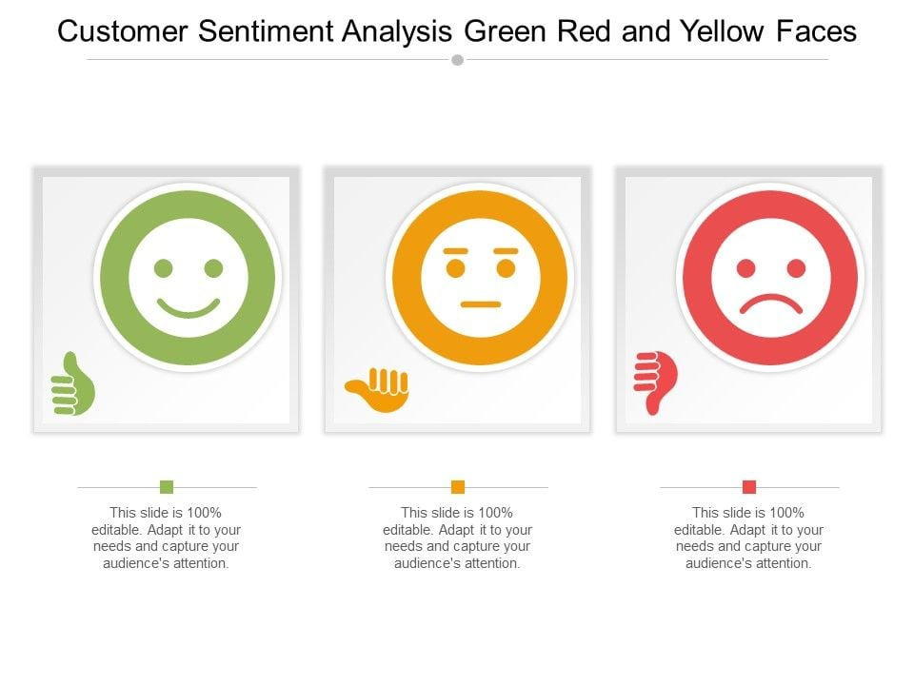
CUSTOMER SENTIMENT ANALYSIS
OBJECTIVE
Analyze customer reviews to understand their impact on brand perception.
Identify key areas of strength and weakness based on customer feedback.
DATA COLLECTION
Sourced from Myntra app & website reviews
Third party review platform (e.g,. Facebook, Instagram, Google reviews)
Social media comments & mentions
BREAKDOWN
High Impact reviews (positive)
Low Impact reviews (negative)
Neutral Impact reviews (Balanced)

Slide 21
HIGH IMPACT REVIEWS (POSITIVE)
REVIEWS
“The clothes arrived quickly and fit perfectly! Will shop again.”
“Excellent quality and variety of options available.”
STRENGTHS
Consumers are pleased with the Quality of the products,
the Quickness
of delivery.
ACTIONABLE INSIGHT
Effective Reinforce in fast shipping and quality in marketing efforts.

Slide 22

2. LOW IMPACT REVIEWS (NEGATIVE)
REVIEWS
“Received the wrong size and it took ages to resolve the issue.”
“The fabric quality was disappointing for the price.”
ACTIONABLE INSIGHT
Focus and make strategies to improve product quality checks, loyalty, logistics, processes to reduce complaints.
CHALLENGES
Complaints regarding Product quality, delivery delays, return on product or money, customer service responsiveness.

Slide 23

3. NEUTRAL IMPACT REVIEWS (BALANCED)
REVIEWS
“Good selection, but delivery took longer than expected.”
“Decent quality, but customer service could be better.”
ACTIONABLE INSIGHT
Conduct surveys to understand specific areas of improvement, continuous monitoring based on neutral feedback & Engage customers to leave feedback after improving service to build trust.
INSIGHTS
Reviews expressing positive shopping experience and indicating room for improvement.

Slide 24
MARKET TREND IDENTIFICATION
Understand current fashion trends and consumer preferences to keep Myntra competitive.
TECHNOLOGY
SUSTAINABILITY
INVEST
PERSONALIZATION
MARKETING
EXPAND
Rise in AR Try-on, Voice and Visual search
COUSTOMER-CENTRIC
FOCUS
STRENGTHEN
Growing demand for Eco-Friendly products
Increase partnership with influencers, encourage user-generated content
Broaden Ethnic and Festive wear options
FLEXIBLE
Improve Customer Service, Quality control & Cash back & Flexible finance options.

Slide 25
STRATEGIC ANALYSIS
of
MYNTRA
SUSTAINABLE INITIATIVES
EFFICIENT DELIVERY
CUSTOMER EXPERIENCE
Key Areas to Focus
OBJECTIVE
To Strengthen Myntra's market position and enhance customer satisfaction.
PRODUCT RANGE
PRODUCT QUALITY

Slide 26
NEW STRATEGIC RECOMMENDATIONS
RECOMMENDATIONS | #1 | #2 | #3 | #4 | #5
CRITERIA | ENHANCE CUSTOMER EXPERIENCE | IMPROVE PRODUCT QUALITY | STRENGHTEN DELIVERY NETWORK | EXPAND PRODUCT RANGE | INVEST SUSTAINABLE FASHIONS
OBJECTIVE | Provide faster and more reliable support | Ensure consistent quality across all product categories | Improve delivery times across regions | Offer a broader variety of brands and styles | Lead in Eco-conscious fashion choices
ACTION - 1 | Expand customer service teams 24/7, especially peak times | Collaborate with High-quality Brands | Partner with local delivery providers in remote areas | Partner with High-end and niche brands | Increase sustainable product options
- 2 | Improve App interface for faster browsing | Strengthen quality control on Myntra's private labels | Open more regional warehouses to speed up delivery | Introduce more sustainable and Eco-friendly brands | Promote eco-friendly initiatives in marketing
EXPECTED OUTCOME | Increase in Customer satisfaction and Loyalty | Reduced returns and Better Brand reputation | Faster delivery, leading to higher customer retention | Greater appeal to a wide range of customer preferences | Attract eco-conscious consumers and strengthen Brand image

Slide 27

WRAP-UP OF MYNTRA ANALYSIS
KEY TAKEAWAYS
To thrive in a competitive market, Myntra must focus on customer sentiment insights, reinforce its strengths, and strategically address areas for improvement.
Prioritizing fast delivery, quality, and responsiveness will strengthen customer trust and loyalty.
By aligning with sustainable, tech-driven, and influencer-led trends, Myntra can enhance its market position.
Implementing regular quality checks, improving logistics, and encouraging customer feedback will support ongoing improvement.
A commitment to these strategies will ensure Myntra remains agile, customer-centric, and well-positioned for sustainable growth in the fashion retail industry.

Slide 28
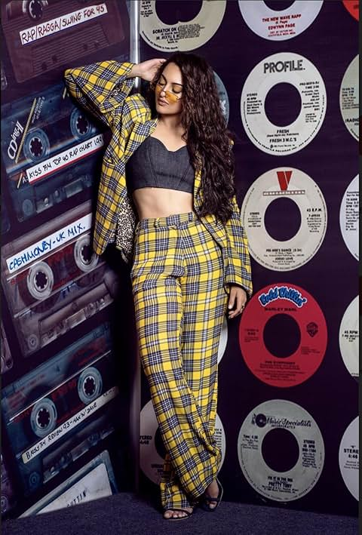
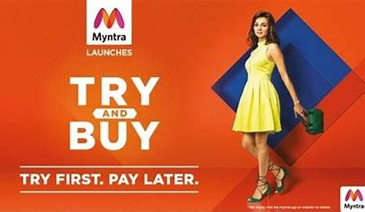

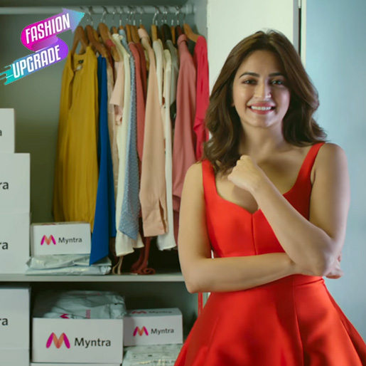


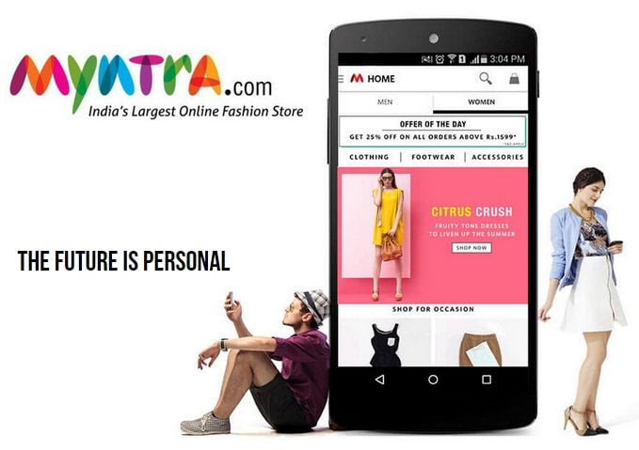
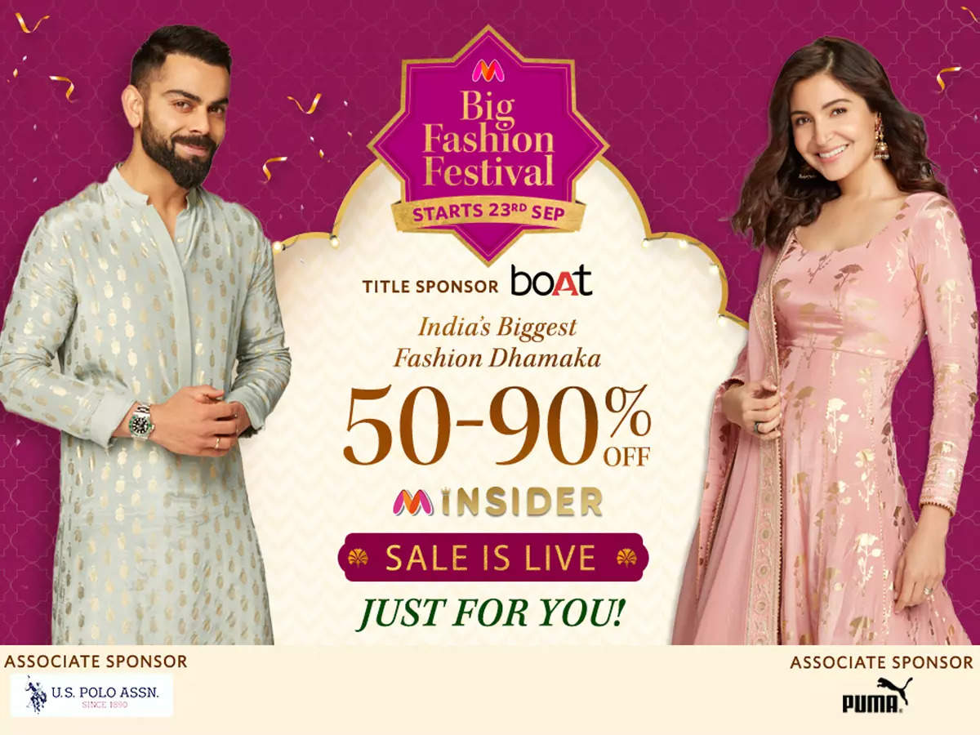
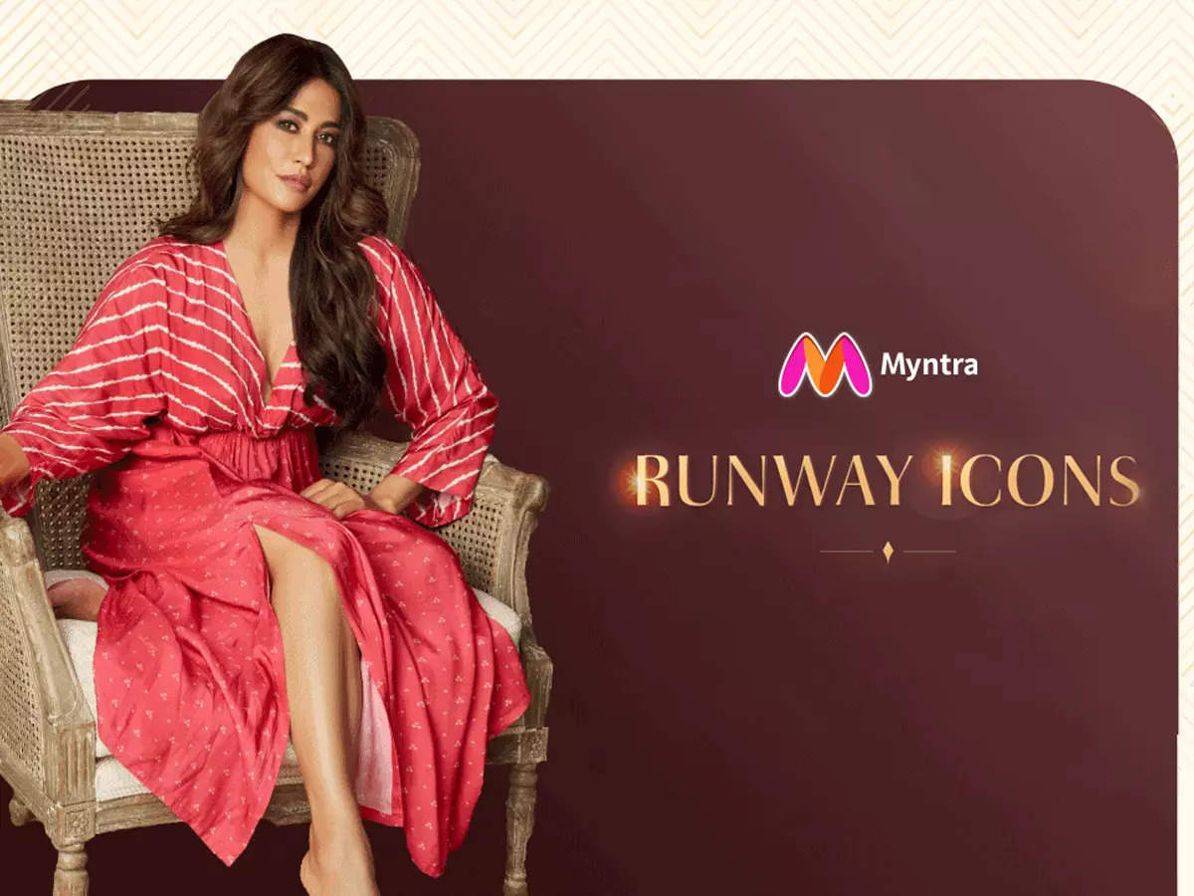
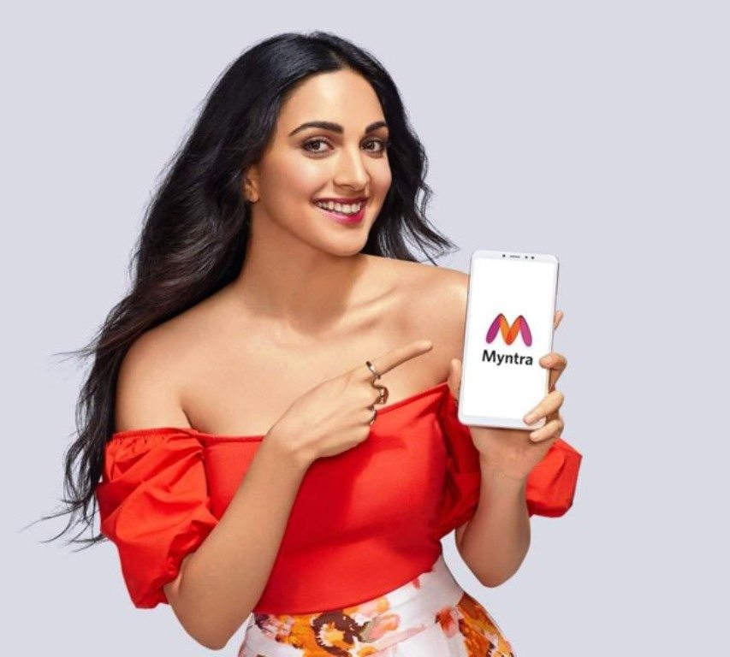
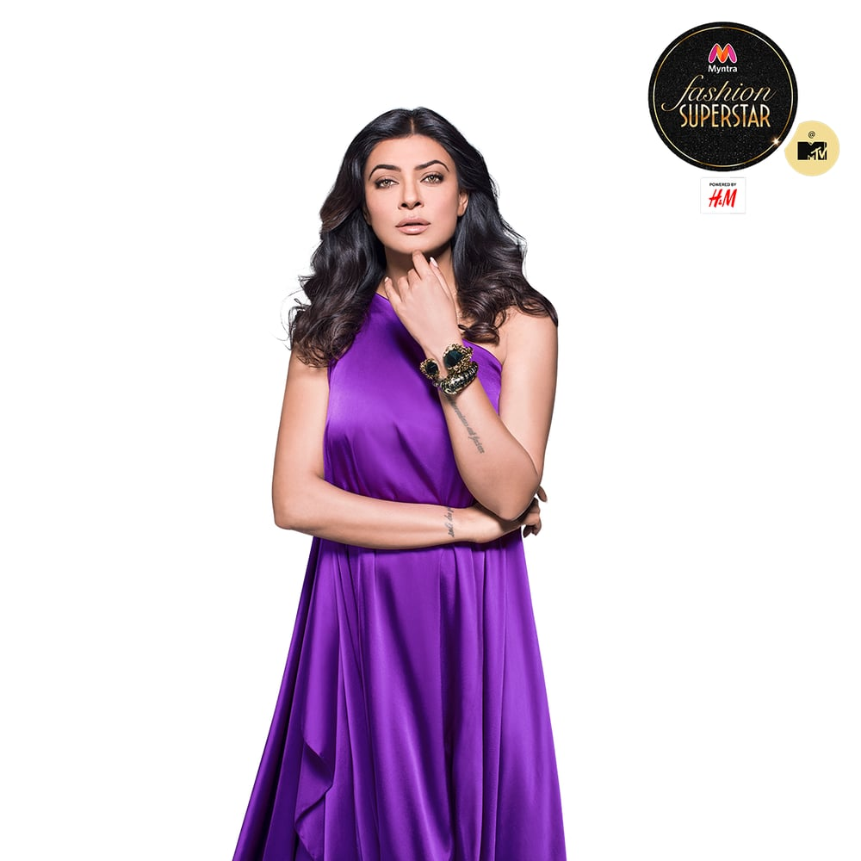
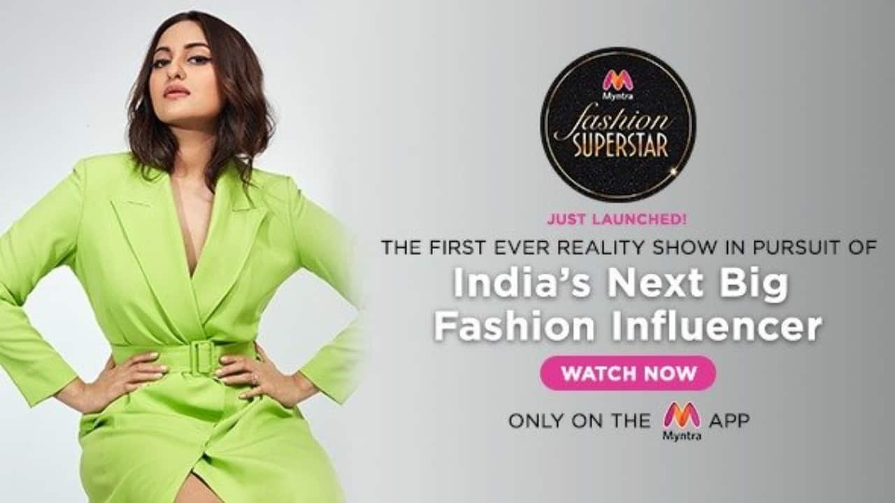




Slide 29



